Slide 1
MSCS 634 · Advanced Big Data and Data Mining
Clickstream Data for
Online Shopping
Finding patterns in how shoppers browse
Hoai Nam Tran · Mohammed Sajjad Mohammed Arif Ansari

Slide 2
Objectives
Understand the data
1
Clean and explore browsing records from an online clothing store
Predict product attention
2
Find which products get the most clicks and why
Predict visitor engagement
3
Tell from early clicks if a shopper will browse deeply
Group sessions and find patterns
4
Discover types of shoppers and products viewed together
2 / 14
Clickstream Data Mining

Slide 3
The Dataset
Online maternity clothing store · April to August 2008
Over 165 thousand
About 24 thousand
217 products
18 to 82 dollars
Clicks
Sessions
Catalogue
Price range
What each click records
Product viewed, its price and colour, where the photo sat on the screen,
page depth, and the visitor’s country. About four-fifths of traffic is from Poland.
3 / 14
Clickstream Data Mining

Slide 4
Cleaning the Data
File format
Constant column
Used a semicolon separator instead of commas
Dropped year — every record was from 2008
Category codes
Missing country
Turned number codes into readable labels
Flagged unknown locations instead of deleting rows
Long sessions
Two views of data
Kept extreme sessions — they are real browsing, not errors
Built a click-level table and a session-level table
4 / 14
Clickstream Data Mining

Slide 5
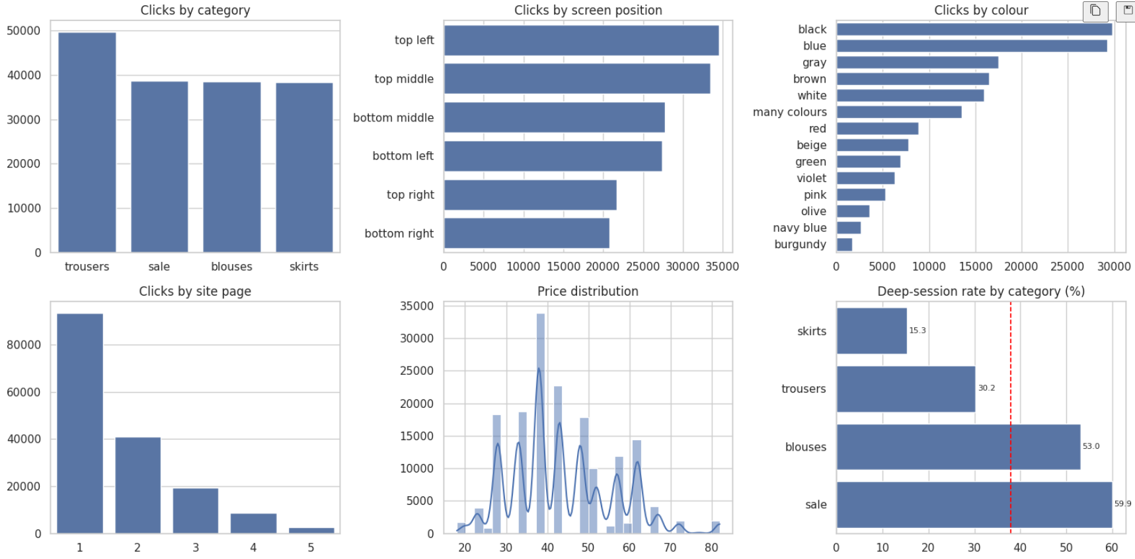
What We Learned from Exploration
Key findings
Every product has one fixed price
Top-left photos get far more clicks than bottom-right
Category affects how deep people browse
Most sessions are short — about four clicks
We work at session level so heavy browsers do not dominate
5 / 14
Clickstream Data Mining

Slide 6
Regression: Predicting Attention
Question we asked
Which products attract attention, and does price play a part?
Why we changed the target
Why product level
Predicting price is not useful — the store already knows its prices. We switched to predicting how many clicks each product receives.
Each product has fixed attributes. Working at click level would repeat the same products thousands of times. We grouped to one row per product.
6 / 14
Clickstream Data Mining

Slide 7
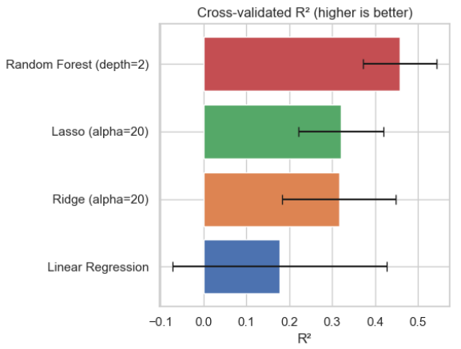
Regression Results
How the models ranked
1
Random Forest (shallow)
Best overall fit
2
Lasso
Close to Ridge
3
Ridge
Strong regularisation helped
4
Linear Regression
Overfit on small data
7 / 14
Clickstream Data Mining

Slide 8
What Drives Attention
Page position
Higher price draws more clicks
The strongest factor. Products on later pages get far fewer clicks because fewer visitors reach them.
Premium products received more attention than budget ones — the opposite of what many expect.
Category matters
Colour is weak
Trousers and skirts attract more interest than sale items. Discounting alone does not drive engagement.
Colour effects were small and inconsistent across models, so we treat them as unreliable.
8 / 14
Clickstream Data Mining

Slide 9
Classification: Early Engagement
Can the first two clicks tell us if a visitor will browse deeply?
Almost 19 thousand sessions with at least two clicks. About half went deep. We only used information from the opening two clicks.
Decision Tree
Nearest Neighbours
Naive Bayes
Best of the three
Close second
Weakest
Tuned for balance between classes
Worked well with scaled features
Still better than guessing
9 / 14
Clickstream Data Mining

Slide 10
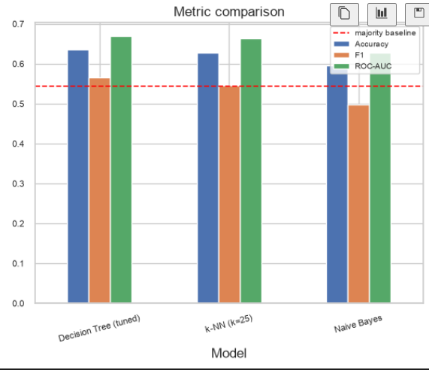
Classification Performance
Takeaway
All three models beat a simple majority guess. The signal from only two clicks is real but modest.
A retailer could use this to offer help or a promotion while the visitor is still on the site.
Missing an engaged visitor costs more than an extra prompt, so the threshold should favour catching deep browsers.
10 / 14
Clickstream Data Mining

Slide 11
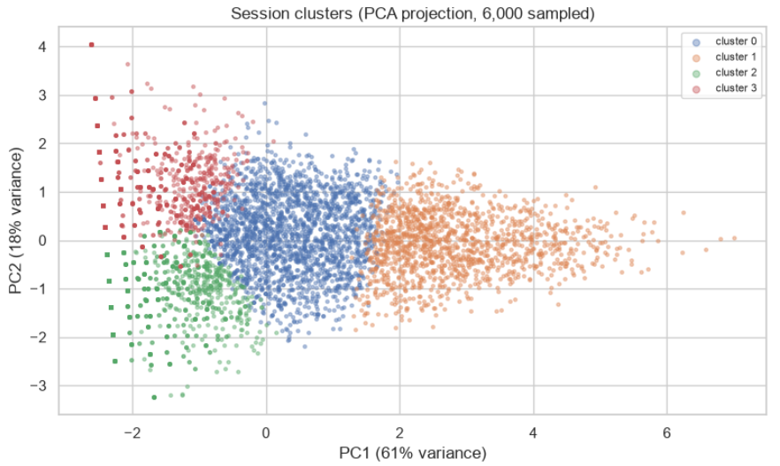
Four Types of Shopping Session
Budget Bouncers (Cluster 2)
Short visits, cheapest items, one category. Looking at price and leaving.
Moderate Browsers (Cluster 0)
Medium-length sessions across a couple of categories and mid-range prices.
Premium Bouncers (Cluster 3)
Also short visits, but highest prices. Need different messaging than budget leavers.
Deep Explorers (Cluster 1)
Long sessions, many categories and colours. Best audience for recommendations.
11 / 14
Clickstream Data Mining

Slide 12
Products Viewed Together
Across categories
Across price levels
Shoppers move between blouses, skirts, and trousers in the same session.
They are building outfits, not hunting for one type of garment.
Budget and mid-to-high items often appear together.
In longer sessions, people look at both cheap and expensive products.
Implication
Recommend complementary items to complete an outfit, not just more of the same category.
12 / 14
Clickstream Data Mining

Slide 13
Recommendations
Put key products early
Premium can lead
Page position is the strongest driver of attention.
Higher-priced items attract more clicks than sale items.
Treat short visits differently
Act on early signals
Budget leavers and premium leavers need different messages.
Two clicks can trigger help or an offer while the visitor is still browsing.
Suggest complete outfits
Focus on deep explorers
Shoppers move across categories — recommendations should follow.
Long sessions are the natural place for personalisation.
13 / 14
Clickstream Data Mining

Slide 14
Key Takeaways
1. We asked about attention, not price — a more useful question.
2. Page placement and category drive clicks; premium pricing draws interest.
3. The first two clicks carry a real but modest signal about engagement.
4. Short visits look the same on bounce rate but differ by price interest.
5. Shoppers build outfits across categories — merchandising should support that.
Thank you · 😊😊😊

